Slide 1
Objectives
In this session, you will learn to:
  Identify various number systems
  Convert a number from one number system to another
Notes:
Start the session by sharing the objectives as given in the slide.
In this session, discuss how to create and modify tables in a Word 2007 document. Discuss the need for representing information in the tabular format. In addition, discuss creating graphics in a Word 2007 document. Working with graphics involves, inserting images and charts in a Word 2007 document.

Slide 2
Representing Numbers as Digital Signals
Computers accept input and deliver output in the form of digital signals.
A digital signal has only two states, represented by two voltage levels, high and low.
For a computer to process numbers, it is important to be able to represent the numbers as digital signals.
To achieve this, you need a number system that uses only two symbols to represent any number.
The binary number system uses only two symbols, 0 and 1, to represent any number, and therefore provides a direct way of representing numbers in computers.
Two other number systems, octal and hexadecimal, help represent binary numbers concisely, making it convenient to deal with large strings of 0s and 1s.
Notes:
Before discussing about creating tables, discuss the need for creating tables in a Word document. Some times the document may contain data in the form of text that is required to be represented in a more readable format. For example, to represent statistical information in a document in a textual form makes it difficult to read and understand. Therefore it is necessary to use tables to represent such information in a document. Tables make information more readily accessible to the reader.
To know more about creating tables, you can refer to the following link:
http://thenewpaperclip.com/2007/01/07/inserting-a-table-in-word-2007/
Demonstrate creating tables in a Word document.

Slide 3
Representing Numbers as Digital Signals (Contd.)
A number system is known by its radix or base.
The decimal number system uses 10 symbols, and therefore, has a radix or base of 10. The binary number system uses two symbols, and therefore, has a radix of 2.
The radix of a number is usually written as a subscript with that number, where the number is written within parentheses, as shown in the following examples:
  (368)₁₀
  (10101)₂
Notes:
Before discussing about creating tables, discuss the need for creating tables in a Word document. Some times the document may contain data in the form of text that is required to be represented in a more readable format. For example, to represent statistical information in a document in a textual form makes it difficult to read and understand. Therefore it is necessary to use tables to represent such information in a document. Tables make information more readily accessible to the reader.
To know more about creating tables, you can refer to the following link:
http://thenewpaperclip.com/2007/01/07/inserting-a-table-in-word-2007/
Demonstrate creating tables in a Word document.

Slide 4
The Binary Number System
The binary number system represents numeric values by using only two symbols, 0 and 1.
Each digit in the binary number system is known as a binary digit or bit.
Counting in binary is similar to counting in the decimal number system.
Applying the decimal counting rules to the binary number system, the following sequence is obtained:
0, 1, 10, 11, 100, 101, 110, 111, 1000, 1001, 1010, 1011, 1100, 1101, 1110, 1111, …
Notes:
After creating a table, it is essential to enter data before navigating in it.
Further, discuss the table navigation techniques. Tell the students that it is more convenient to use the key combinations to navigate in a table.

Slide 5
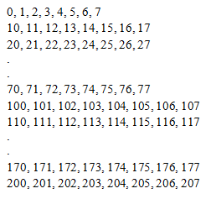
The Octal Number System
The octal number system uses 8 symbols, from 0 through 7. The radix of the octal number system is 8.
Counting in the octal number system is same as counting in the decimal number system.
Applying the decimal counting rules to the octal number system, the sequence shown in the following figure is obtained.
Notes:
Once a table is created, you can modify its properties to enhance the readability of the
data that is displayed. For example, you can alter the size of the table, the height and
width of the rows and columns, and the alignment of text in the table. You can also apply
different borders and shading options to the table.

Slide 6
The Hexadecimal Number System
The hexadecimal number system uses 16 symbols, from 0 through 9, and then from A to F. The radix of the hexadecimal number system is 16.
Counting in the hexadecimal number system is same as counting in the decimal number system.
Notes:
Once a table is created, you can modify its properties to enhance the readability of the
data that is displayed. For example, you can alter the size of the table, the height and
width of the rows and columns, and the alignment of text in the table. You can also apply
different borders and shading options to the table.

Slide 7
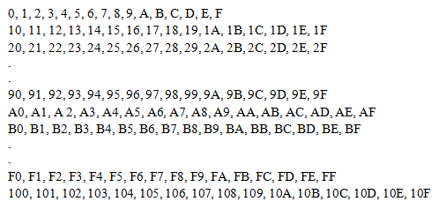
The Hexadecimal Number System (Contd.)
Applying the decimal counting rules to the hexadecimal number system, the sequence shown in the following figure is obtained.
Notes:
Once a table is created, you can modify its properties to enhance the readability of the
data that is displayed. For example, you can alter the size of the table, the height and
width of the rows and columns, and the alignment of text in the table. You can also apply
different borders and shading options to the table.

Slide 8
Conversions Between Number Systems
At times, you need to covert a number from one number system to another.
Distinct methods have been defined for conversion between each pair of number systems.
Notes:
Tell the students that in addition to modifying the information displayed in a table, the table structure can be modified. In other words, the number of rows and columns in the table can be altered. Discuss the various options for modifying a table.
Demonstrate modifying a table.

Slide 9
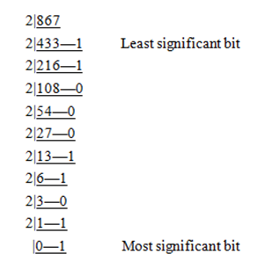
Converting Decimal Numbers to Their Binary Form
  You can convert a decimal number to its binary form by using the method of successive division by 2, the radix of the binary number system.
  The following figure illustrates the conversion of the decimal number, 867 to its binary equivalent, 1101100011.
Notes:
When a table is created, the Table Tools Design contextual tab appears on the Ribbon. This tab contains various groups with options that help in formatting the table. In addition, discuss converting text to a table and table to text.

Slide 10
Converting Binary Numbers to Their Decimal Form
  A binary number can be converted to its decimal form by adding the place values of all bits in the number.
  The place value of the i^{th} bit from the right is given as the product of the bit with 2^{i-1}.
  The following figure illustrates the conversion of the binary number, 1010011 to its decimal equivalent, 83.
Notes:
When a table is created, the Table Tools Design contextual tab appears on the Ribbon. This tab contains various groups with options that help in formatting the table. In addition, discuss converting text to a table and table to text.

Slide 11
Summary
In this session, you learned that:
  The binary number system offers a direct way of representing numbers as digital signals.
  The rules of decimal counting apply to binary, octal, and hexadecimal counting also.
  Octal and hexadecimal number systems help in concisely representing binary numbers.
  The number of symbols that a number system uses is called the radix of that number system.
  Numbers can be converted from one number system to another.
  A decimal number can be converted to any other number system by dividing the number repeatedly by the radix of the desired number system.
Notes:
Summarize the session by using the points given in the slide.

Slide 12
Summary (Contd.)
  A number in any other number system can be converted to a decimal number by adding the place values of all the digits in the number.
  For a number in any number system, the place value of the i^{th} digit from the right is given as the product of the digit with r^{i-1}, where r is the radix of the number system.
Notes:
Summarize the session by using the points given in the slide.

